Slide 1
Case 3- OpenAI gym Utilizing Neural Network in Seaquest
Group 6
AAshish bagul
Fangzheng Sun
Huanhan Liu
Qian Xu

Slide 2
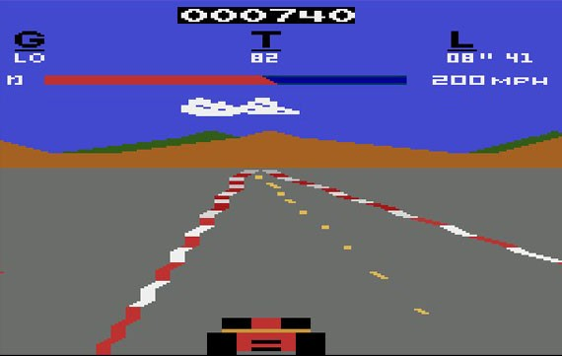
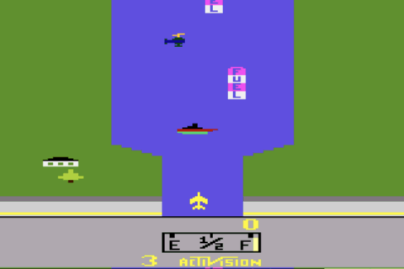
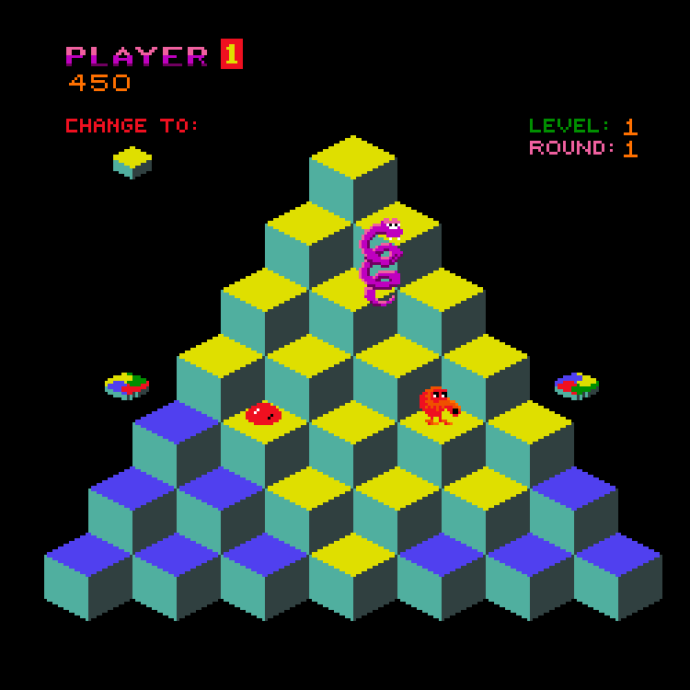
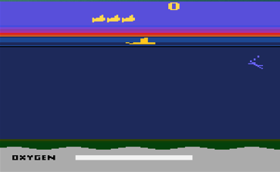
Open AI & Atari Games
Slash Gear
Air Raid
Q-Bert
Sea Quest

Slide 3
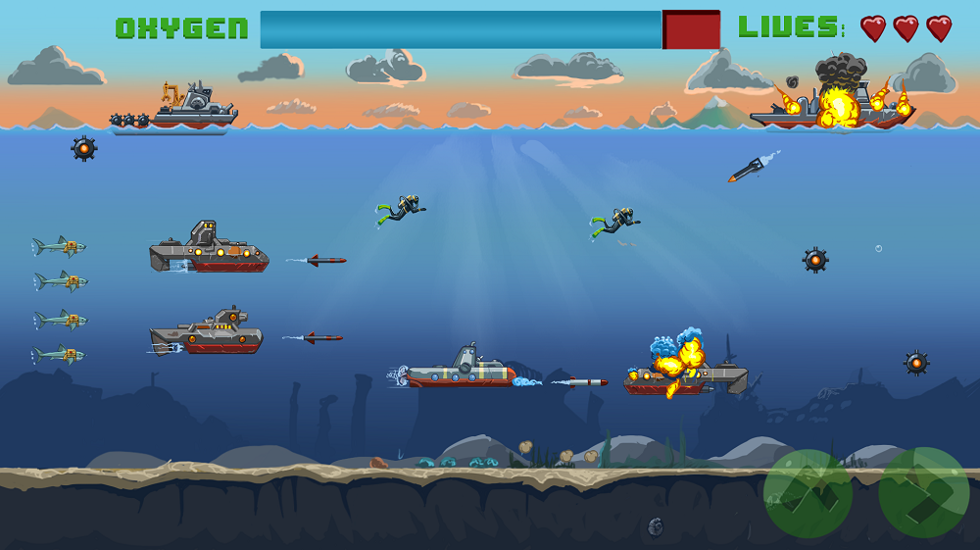
SeaQuest Game
Seaquest is an underwater shooter in which the player controls a submarine
Enemies- Sharks and Enemy Submarines
Objective- Eliminate Enemy Submarines and Rescue Swimming Divers by maintaining level of Oxygen.
The agent needs to decide on 2 of the four possible actions: move the submarine left or right and shoot.

Slide 4
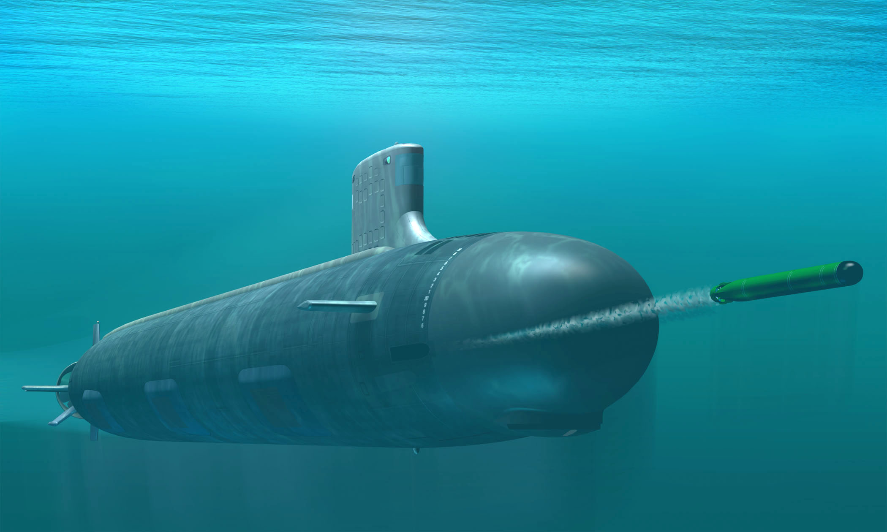
Analogy to Real World
The Agent can be used to drive self driven submarines which can be used for defence and offence purposes.
This Agent can be used to build intelligent Submarines.

Slide 5
Machine Learning
Using algorithms that iteratively learn from data, machine learning allows computers to find hidden insights without being explicitly programmed where to look.
Reinforcement learning is concerned with how an agent ought to take actions in an environment so as to maximize some notion of long-term reward.

Slide 6
Exploration Method
Our algorithm is based on the article Deep Reinforcement Learning: Pong from Pixels
In the article, the author applied neural network in Pong game. Computer makes decision of the action from the historical rewards/punishments (upward or downward). It’s a binary choice based on the possible score of going up or down.

Slide 7
Our Algorithm - For Pacman
Instead of the binary choices in Pong game, we have 4 possible actions in Pacman:
1 - up 2 - right 3 - left 4 - down
We divide the actions to odd and even numbers. With odd numbers, we compare the scores of action 1 and 4, and generate the best possible action among this two. With even numbers, we compare the scores of action 2 and 3, and generate the best possible action.
As a result, pacman can move in all directions!

Slide 8
Our Pacman Training Results
Without training
With 3000 episodes of training

Slide 9
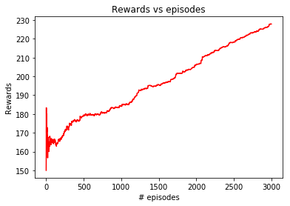
Historical Average Scores In Pacman Training

Slide 10
Our Algorithm - For Seaquest
Instead of the binary choices in Pong game, we have 5 possible actions in Seaquest:
1 - shoot 2 - up 5 - down 8 - right 9 - left
We divide the actions by n%4 = 0, 1, 2 or 3. With n%4 = 1 or 3, the computer makes the decision to shoot; With n%4 = 0, we compare the scores of action 2 and 5, (moving up or down) and generate the best possible action; With n%4 = 0, we compare the scores of action 8 and 9, (moving right or left) and generate the best possible action.

Slide 11
Our Seaquest Training Results
Without training
With 1000 episodes of training

Slide 12
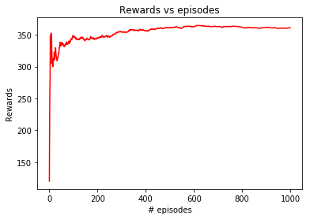
Historical Average Scores In Seaquest Training

Slide 13
Limitation
Since our algorithms divide the actions by its index, in each steps we actually have only 2 choices (although in general every actions can be used). This decreases the flexibility and intelligence of the AI.
As the flexibilities of games increase(4 possible choices for Pacman and 5 possible choices for Seaquest), we need more trainings before the perfect decision-makings. And we didn’t have enough time to do this.. ☹☹☹☹

Slide 14
Conclusion
We learned Neural Network algorithm from the article Deep Reinforcement Learning: Pong from Pixels
Then we extended the machine learning into more complex games, Pacman and Seaquest
The Seaquest game inspired us that the similar processes can be applied to Self driven intelligent submarines.

